Slide 1


NZ Job Analysis
All information are collected from Seek, Stats NZ
Use case
01
Company & Job
02
Salary & Job
03
Salary & Post time
04
Location & Job & Salary

Slide 2

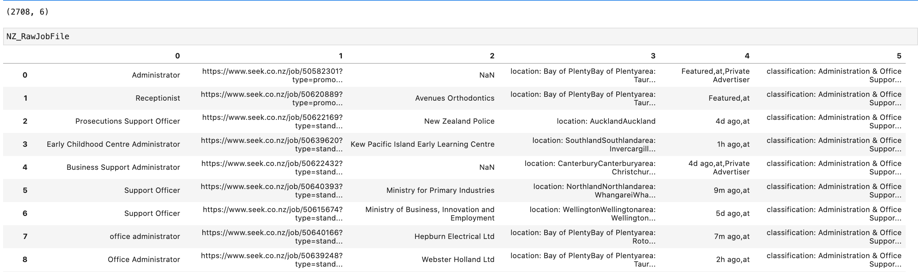

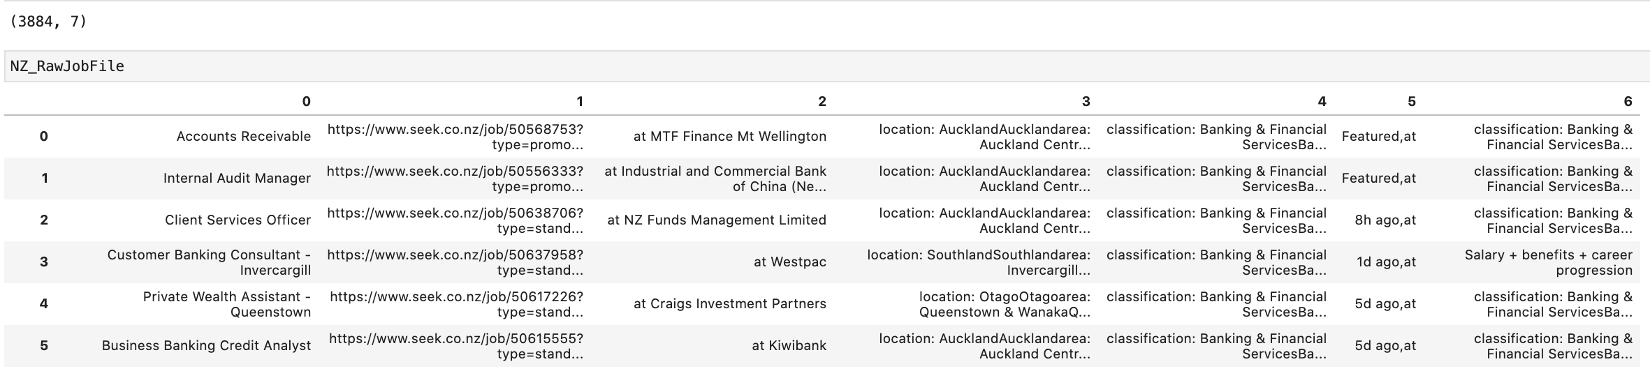
NZ Raw Data Review
Admin Job – Row=2708, Columns=6
Bank Job – Row=3884, Columns=7

Slide 3




NZ Raw Data Review
Column:
0
Column:
2
Column:
3
Column:
4/5
Column:
4/5/6
Column:
4/5/6
Specific job titles of Admin/ Bank domain
Company names who provide job opportunities
The job locations
Brief time for posting job positions
Specific job titles of Admin/ Bank domain
Salary randomly stored in various cols, formats are different – converted into annual salary
Job Title
Company
Location
Post Time
Classification
Salary Range
More info can be retrieved from raw data, depending on requirements and time

Slide 4
Data Reprocessing
Extract
Delete duplicate
Clean
Fillna
 | Admin Job | Bank Job
Row Num | 2708 | 3597
Column Num | 6 | 11

Slide 5
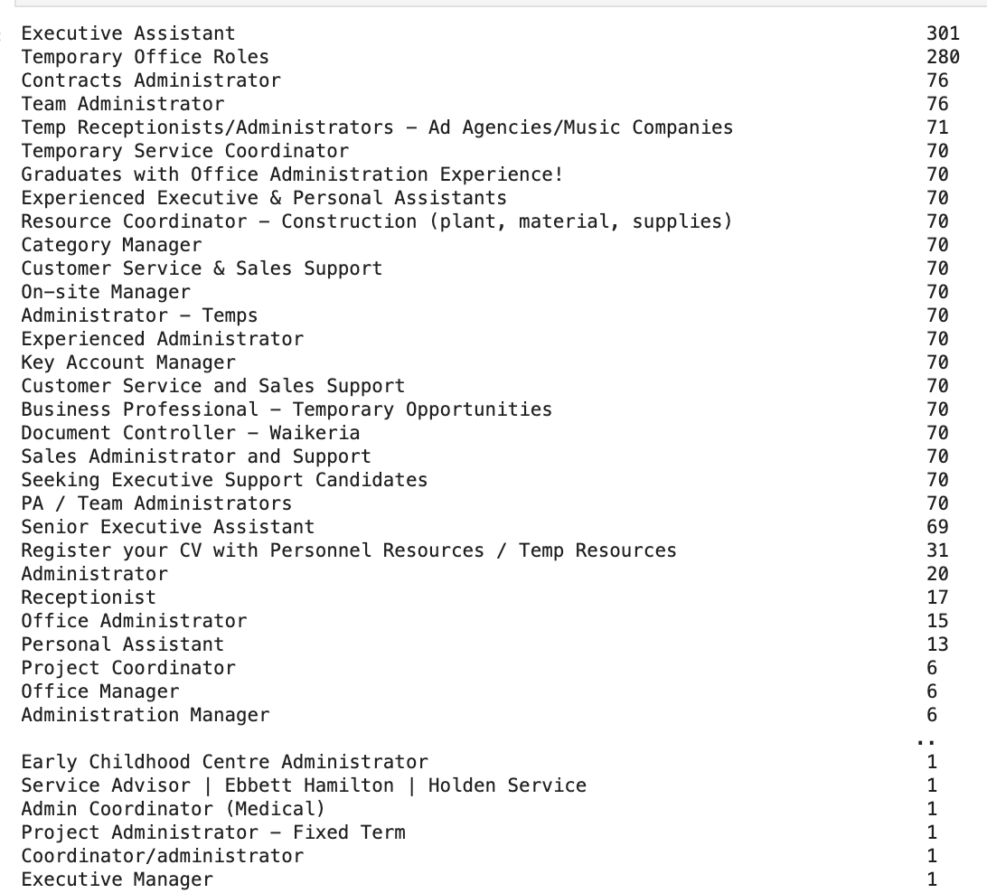
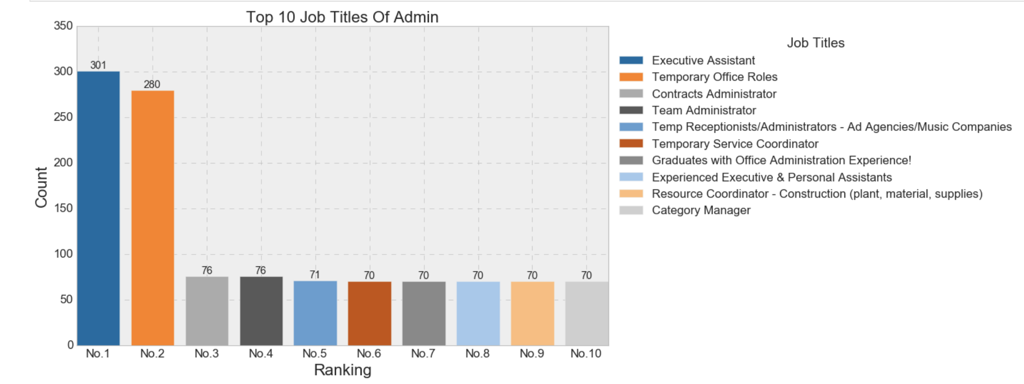
Visualize Admin Data
Main Admin Job Titles
Select the top 10 Admin Job titles
Executive Assistant
Temporary Office Roles
Contracts Administrator
Team Administrator
Temp Receptionists/Administrators
Temporary Service Coordinator
Graduates with Office Administration Experience
Experienced Executive & Personal Assistants
Resource Coordinator - Construction
Category Manager
…….
(Other job titles with 70 numbers are not shown in the chart)
Background in data:
Temporary office roles belong to contract roles, and contract roles’ salary is normally higher than full-time roles. In addition, contract roles have high turnover. Thus, the demand for this kind of jobs will be high.

Slide 6
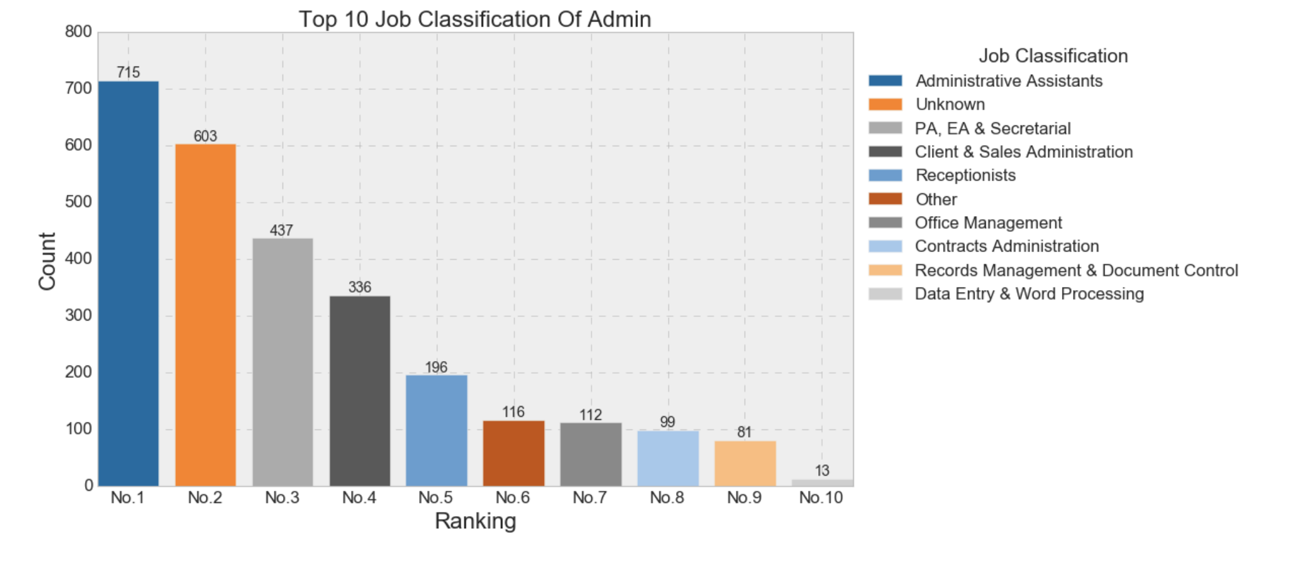
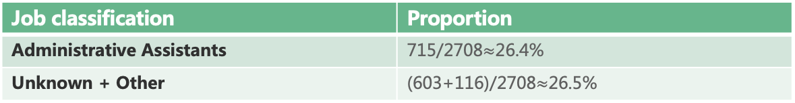
Visualize Admin Data
Admin Job Categories
Top categories
Administrative Assistants
Unknown
PA,EA& Secretarial
Client & Sales Administration
Receptionists
Other
Office Management
Contracts Administration
Records Management & Document Control
Data Entry & Word Processing
Problems in data:
Unkown classifications are too much, will cause the indetermination of analyzing the demand of specific admin jobs. This can be solved by analyzing other columns potential info or introducing reference data.
However, the only thing can be studied from the data is that Administrative Assistants must be the most popular(the scarcest)admin job.
Job classification | Proportion
Administrative Assistants | 715/2708$≈$26.4%
Unknown + Other | (603+116)/2708$≈$26.5%
The Admin Category - Administrative Assistants has the highest demand, occupying 26.4% job positions

Slide 7
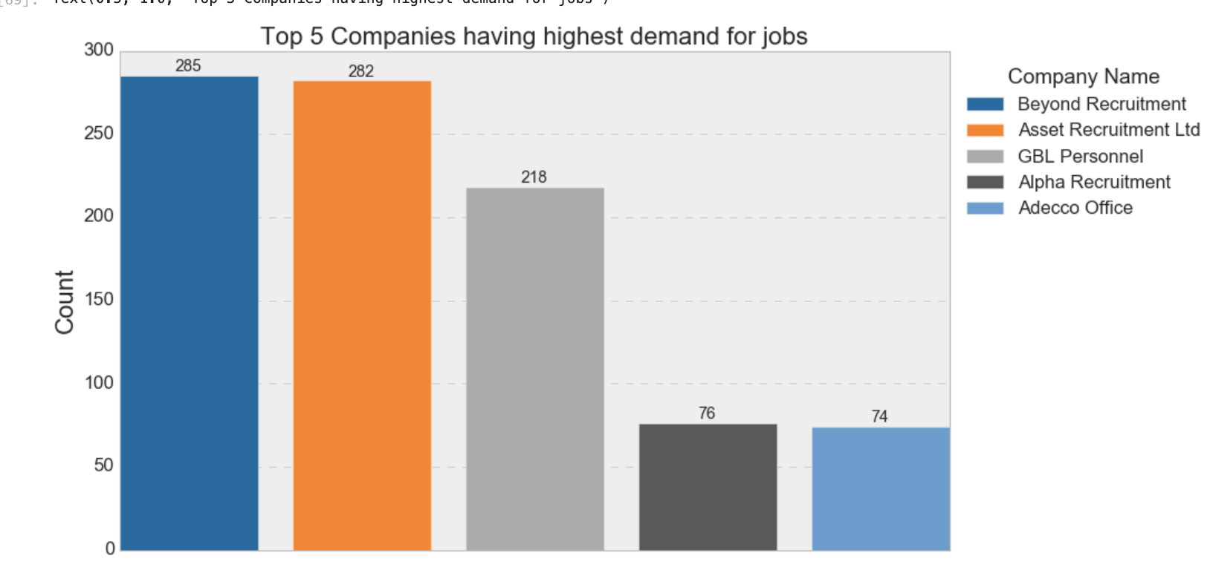
Visualize Admin Data
Companies with highest admin job demand
From bar chart, the top 5 companies providing the most admin job opportunities are all recruitment agencies. This means that admin jobs are popular among agencies, but their end-clients’industries can not be found from this chart.

Slide 8
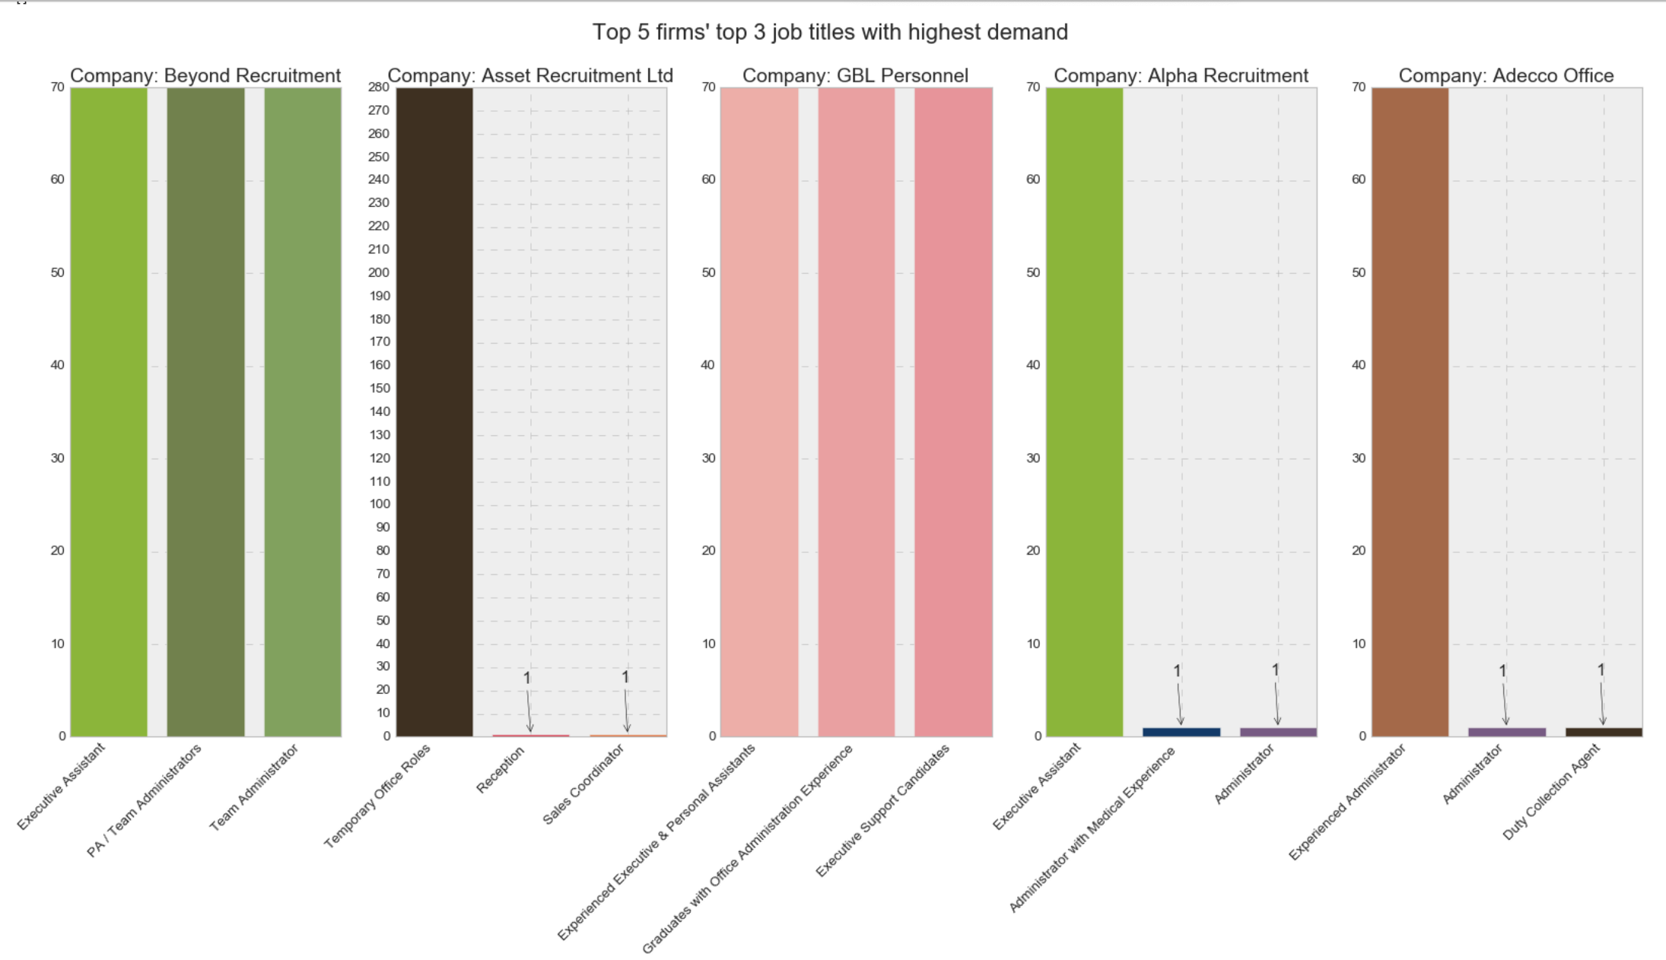
Visualize Admin Data
More details from company and jobs
From bar chart, y axis represents the number of demand for jobs, x axis represents the scarcest job titles at the related companies. Each chart stands for different companies, the sequence of companies shown depends on the results of the last chapter.
From bar chart, y axis represents the number of demand for jobs, x axis represents the scarcest job titles at the related companies. Each chart stands for different companies, the sequence of companies shown depends on the results of the last chapter.

Slide 9
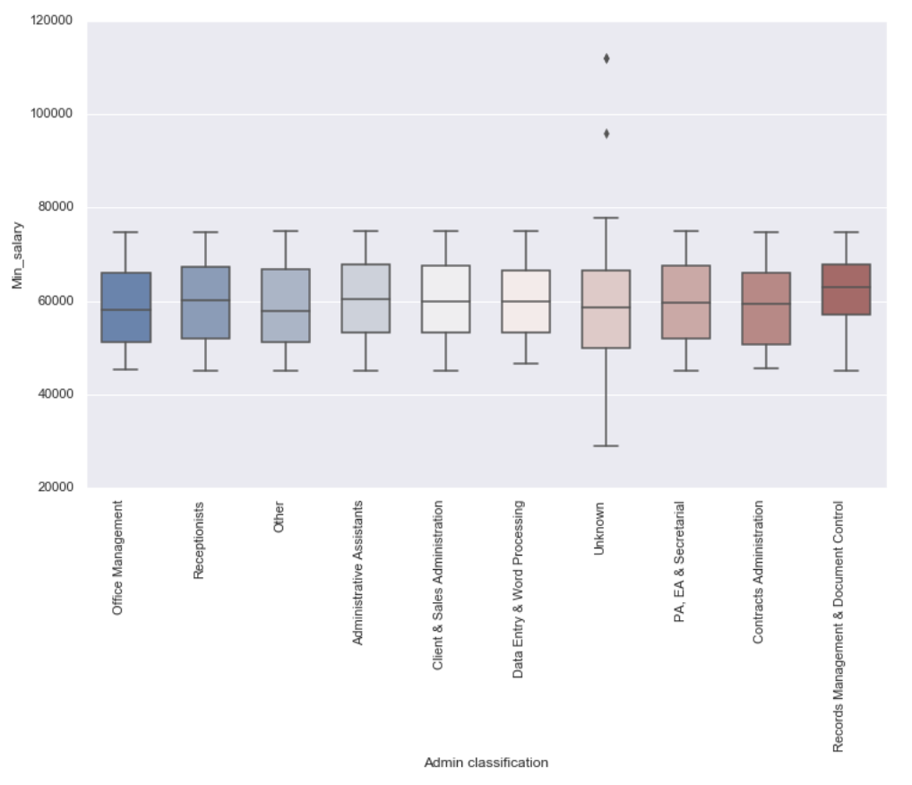
Visualize Admin Data
Distribution Of Salary Of Admin Categories
From Box Plot, the median minimum salary of all admin jobs is around 60K
The scarcest Administrative Assistants position mentioned in last chapter, its minimum salary rage is between 45000 and 75000. (Most salary is randomly got from Glassdoor.
Data entry & Word processing category has the lower median salary, but its range is smallest, means this type of job provides stable package.
Problems in data:
Box Plot can find out some outliers. The salary of unknow category is different from others, its highest minimum salary can reach up to 80K, while its lowest minimum salary can go down to 25K.
Background Explanation
In raw data, some jobs like part-time/temporary ones provide hourly rate. In order to show data consistently, I transferred all daily rate into annual salary (calculate by 8 hours* 200 days) when doing data reprocessing. Thus, this will cause some jobs’ salaries are obviously low than the normal ones.
Contract roles’ salary is usually higher than the full-time roles.

Slide 10
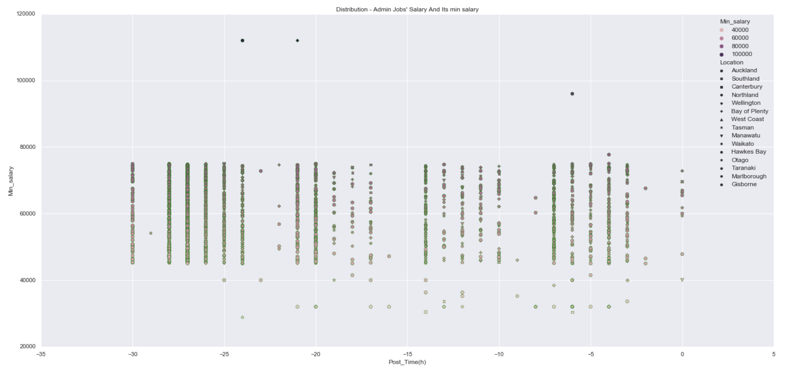
Visualize Admin Data
Post Time & salary
In order to understand jobs’ salary, I build a distributional scatterplot to show salary distribution based on post time and location.
Most of salaries are distributed among 45K to 75K. Closer to the time, more obviously lower salaries are shown. Combining with Distribution Of Salary Of Admin Categories, all those 'strange' salary points outside main distribution belong to unknown admin category.
Additional info: Post time is processed based on hours.

Slide 11
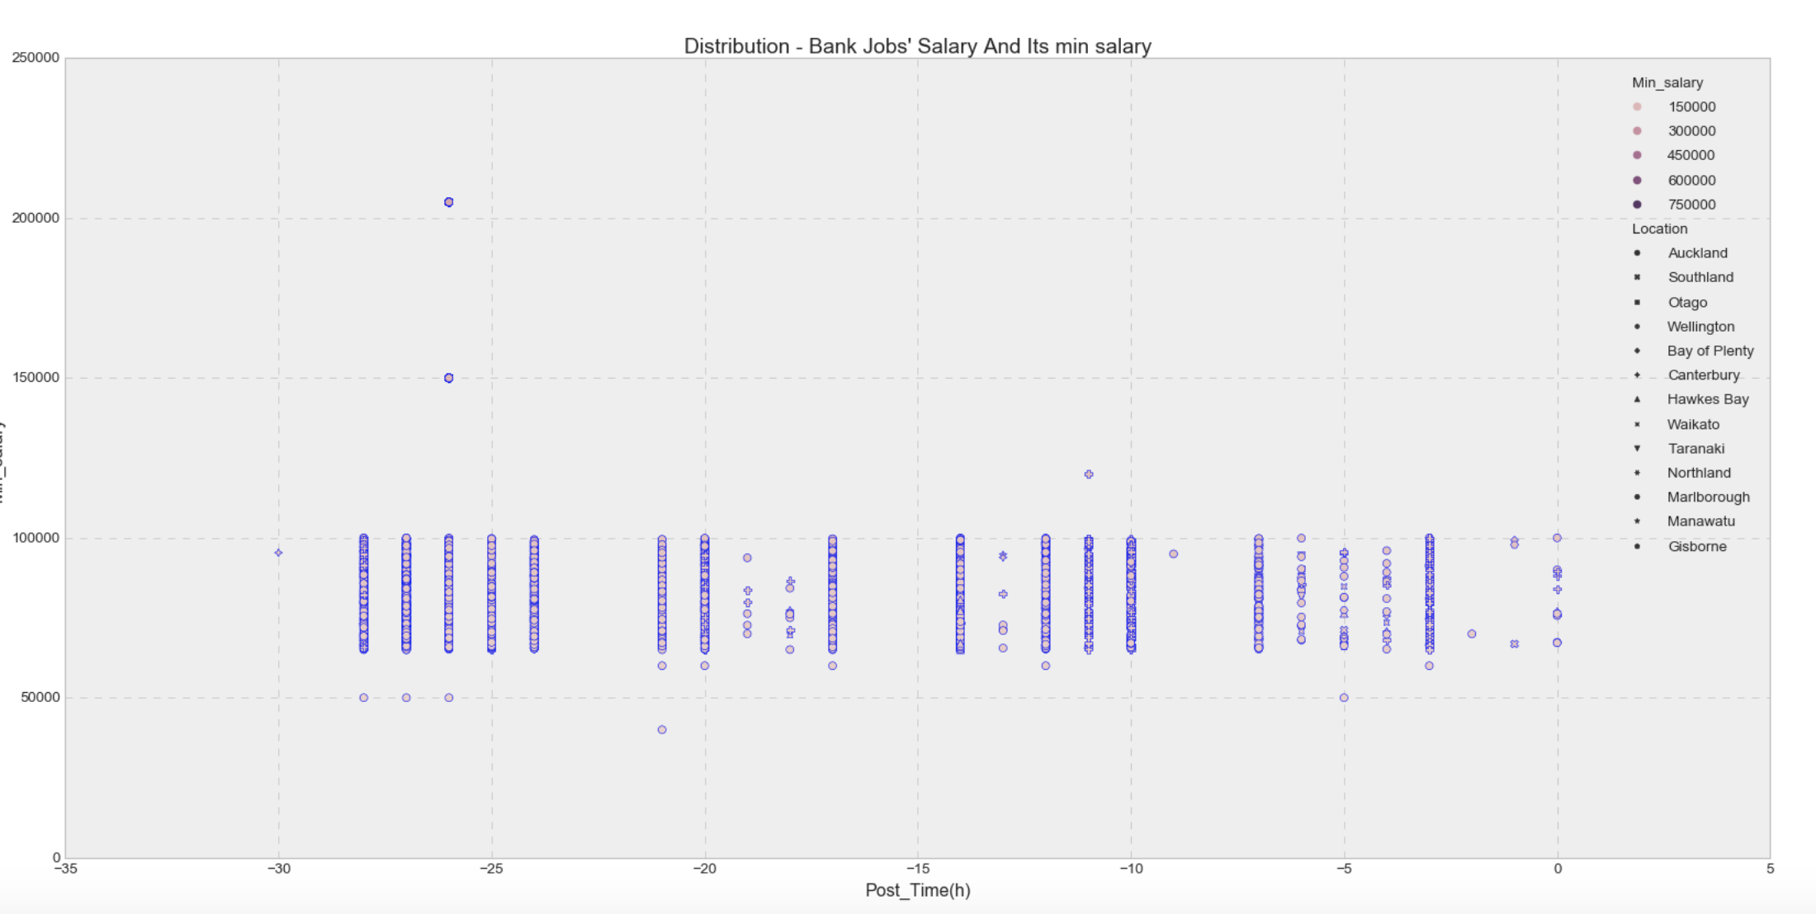
Visualize Bank Data
To understand salary level of admin job at the market
Add Bank job data as comparison
Same post time, banking salary range mostly is around 60K to 100K, quite higher than Admin ' s
Problems in data:
A few strange salary points , much higher than others.

Slide 12
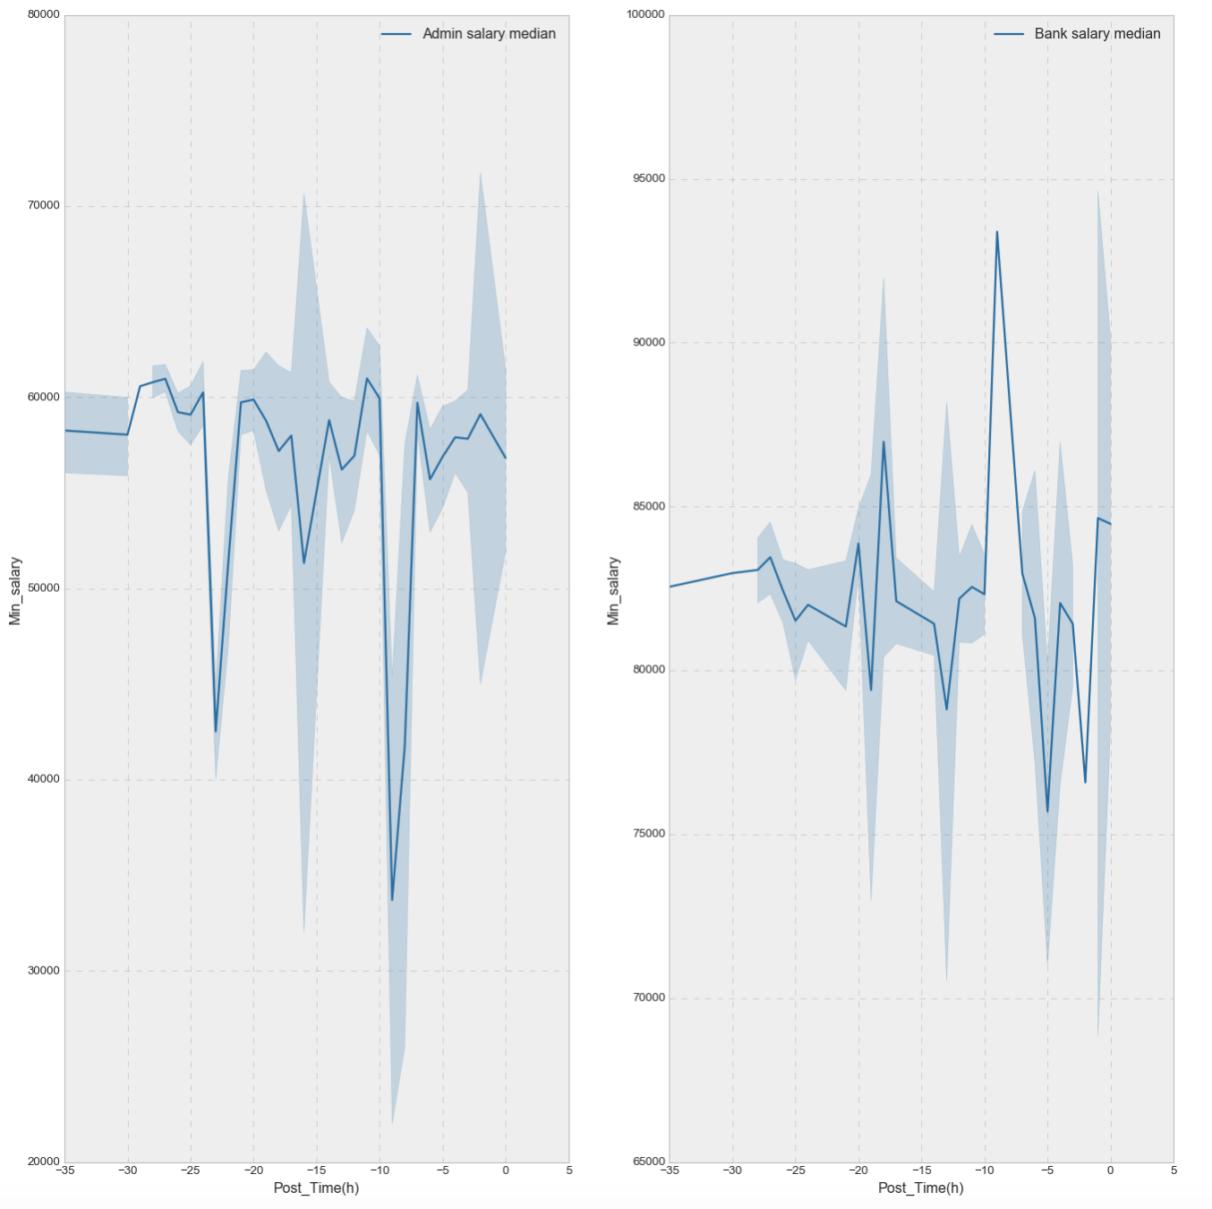
Comparison-Bank Data VS Admin Data
Delete Strange Points
Confidence interval shows the degree to which the true value of this parameter has a certain probability to fall around the measurement result, and it gives the confidence degree of the measured value of the measured parameter.

Slide 13
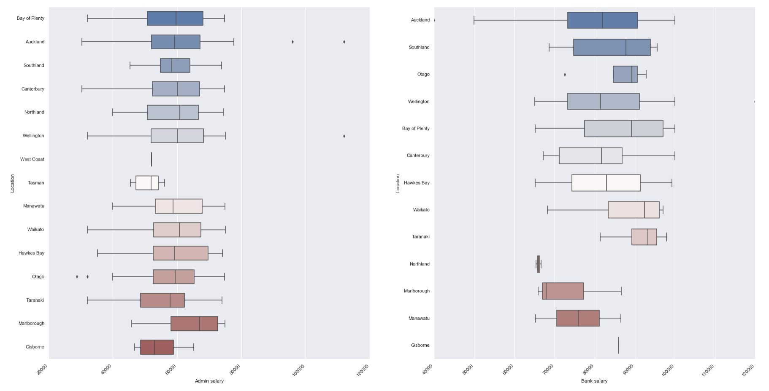
Brief understanding of each location & salary
Boxplot reflects that admin median salary is almost stable around 60000,but West coast only one line because it only has one data or same values in this area. (we will study this question further later)
While we can see some outliers on the right side located in Auckland, Wellington and some left outliers are located in Otago. West Coast only has one data value for admin and Gisbome also has one data. These will be considered when doing area distribution and salary’s area ranking in case these will affect analysis.
Admin salary has a large distribution span but has stable median range. While bank salary’s median range is unstable, from 70000 to 90000.

Slide 14
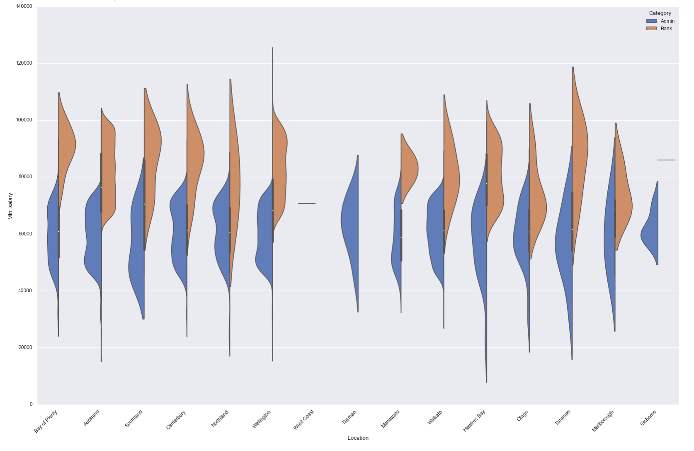
Brief understanding of each location & salary
Violin plots are used to show the distribution and probability density of multiple sets of data. Similar to the box plot, but better at the density level. Fatter area means more values located in this range.
Obviously, orange area is higher than blue one, this verifies again that bank’s salary level is higher than admin.

Slide 15
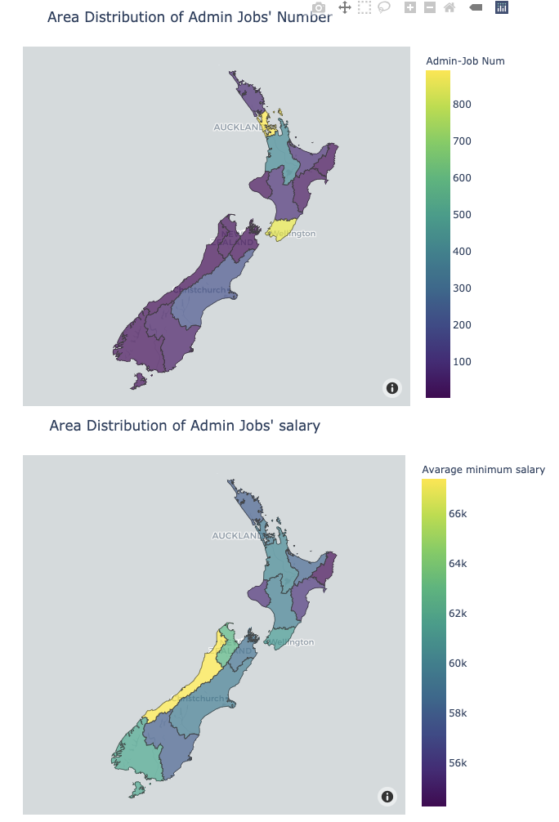
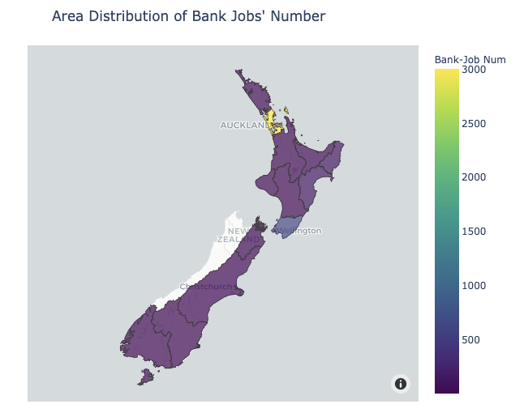
Area distribution of Jobs
No.1
Auckland Region
889
No.2
Willington Region
854
No.3
Waikato Region
404
No.1
Auckland Region
3002
No.2
Willington Region
595
No.3
Hawke’s Bay Region
124

Slide 16
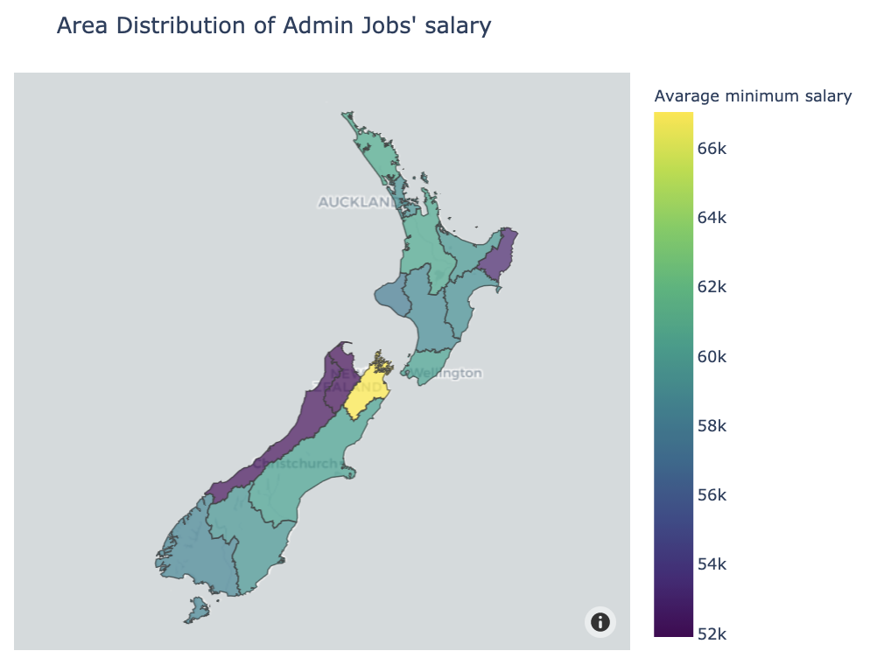
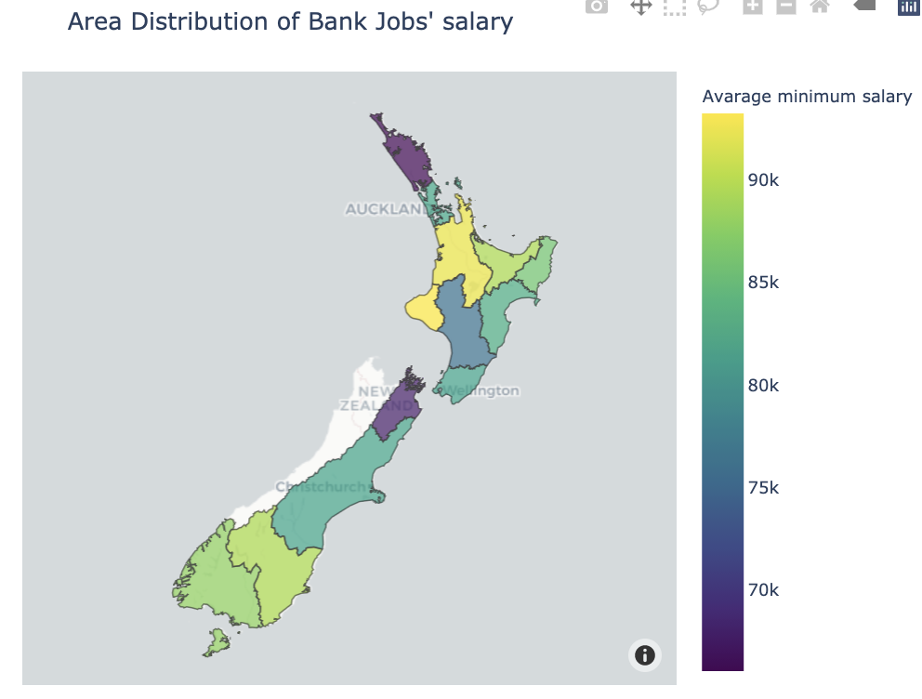
Area distribution of Salary
Area Ranking of salary will be set a threshold of numbers, to prevent some single largest data from affecting the whole ranking. In this project, only area with more than 20 jobs can be considered into salary ranking.
No.1
Northland Region
70K
No.2
Waikato Region
61K
No.3
Canterbury Region
60K
No.1
Gisborne Region
86K
No.2
Hawke’s Bay Region
83K
No.3
Canterbury Region
82K

Slide 17
Location & salary summary
Job opportunity
Whatever Admin jobs or Bank jobs, there are much more chances provided in the upper side (North) of New Zealand.
Salary
Popular Region
It looks like North side of New Zealand has more possibility to offer high-paid admin/bank jobs
Through last map, Auckland is clearly the most popular region that attracts jobs.
Problems
Salary distribution depends on jobs‘ median min salary, some regions only have a few job positions, but these positions provide much high salary, causing the whole region’s salary ranking among others. Thus, in last chapter, I set a threshold that skipping any region with less than 20 jobs.

Slide 18
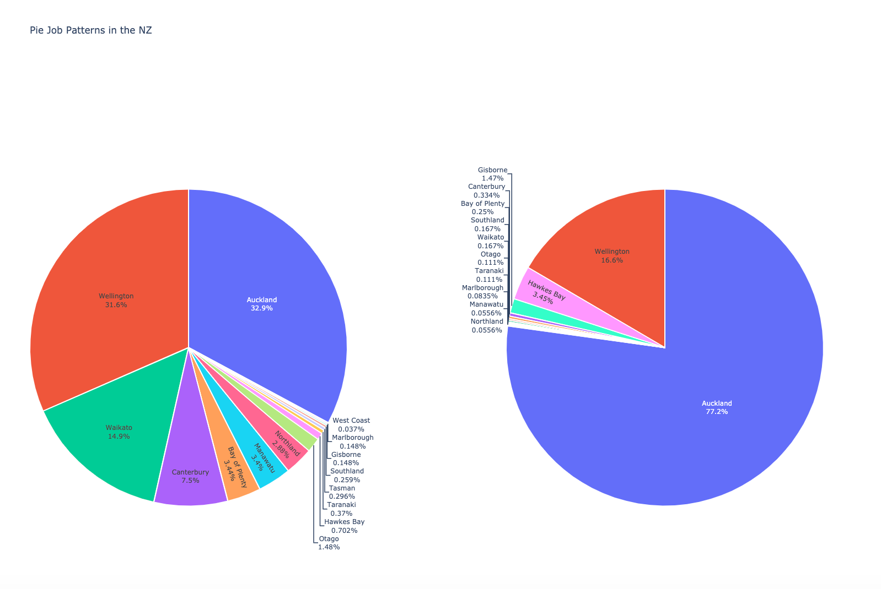
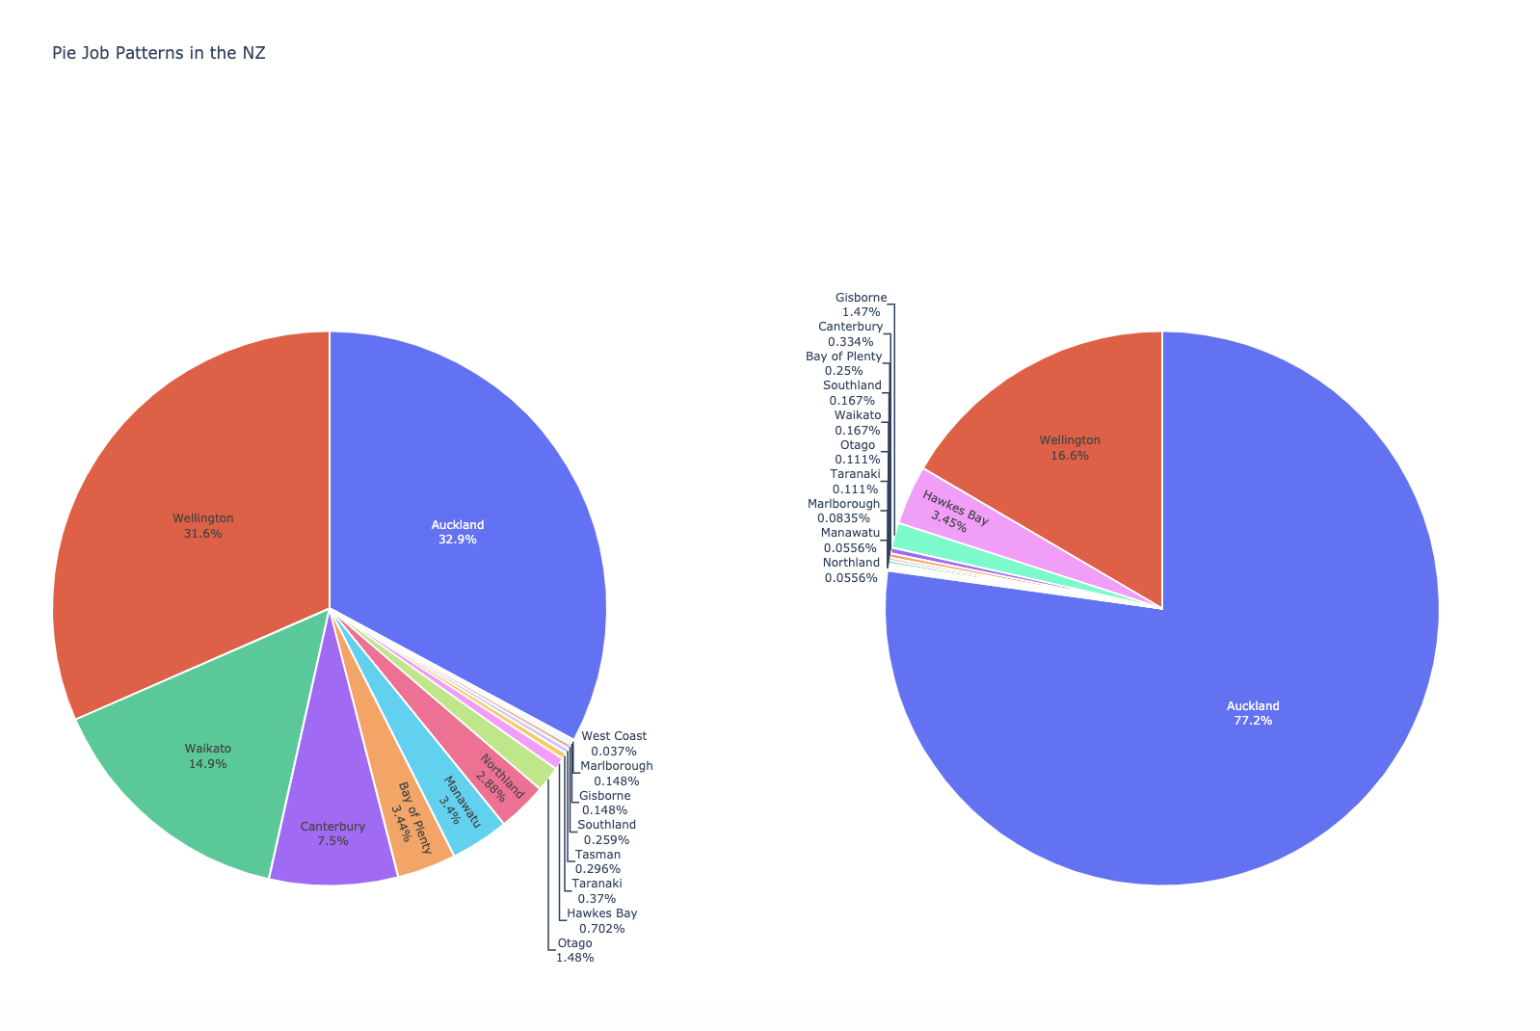
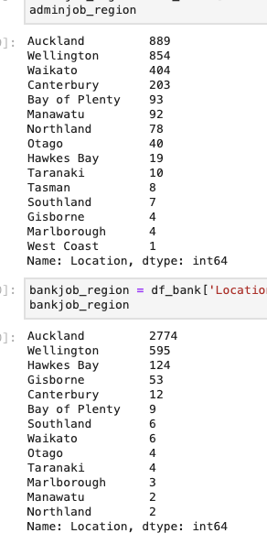
Look further into job opportunities from each region
The regions with highest salary jobs (Admin, Bank) shown in the map only got a few job demand, so the average salary of these regions is not reliable. These two pie charts can easily show each region‘s job’s demand.
Admin
Bank

Slide 19
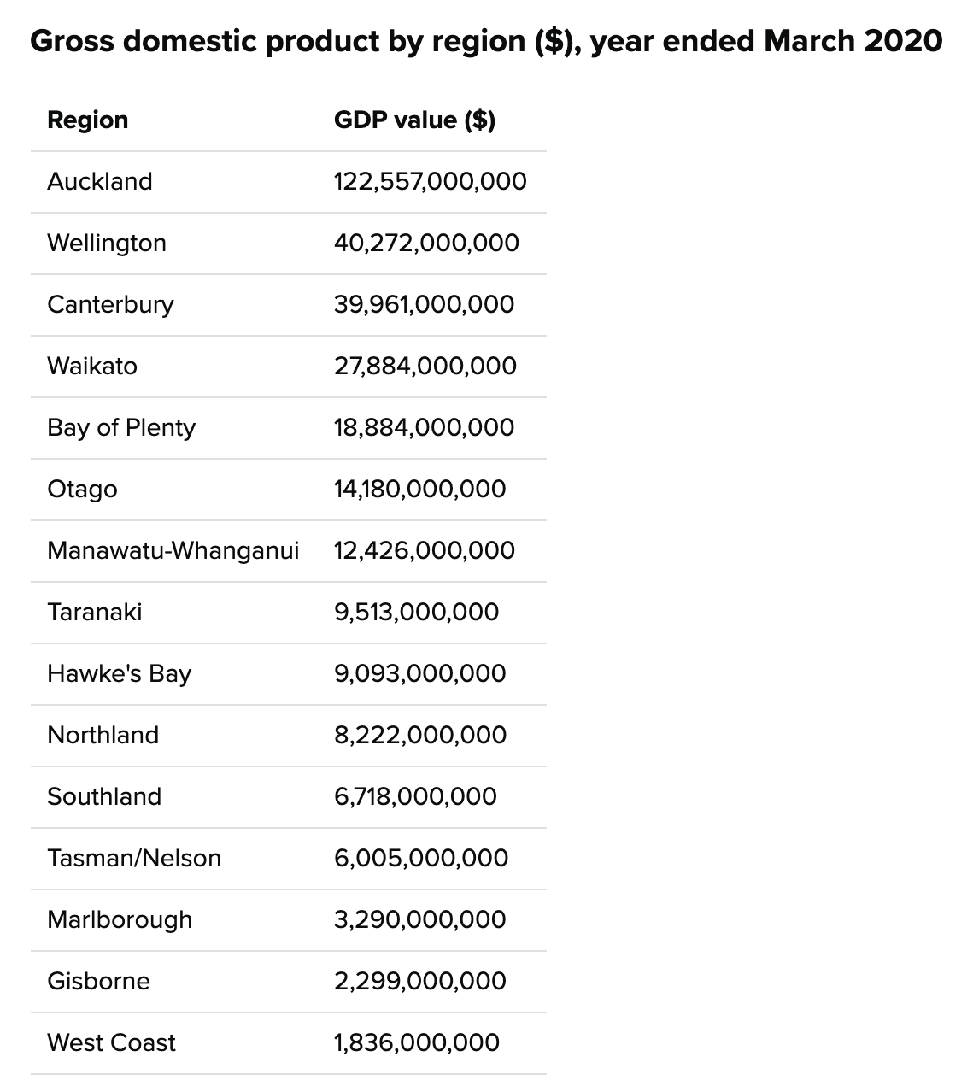
NZ GDP
GDP per capita
Taranaki
$76,715
Wellington
$74,785
Auckland
$71,978
Other Regions
North Island
South Island
22.3%
77.7%
Data from Stats NZ

Slide 20
NZ Unemployment Rate
Region | Unemployment rate | Chance rate(Admin) | Chance rate(Bank)
Taranaki | 6.3% | 0.37%, | 0.11%
Gisborne, Hawke's Bay | 5.7% | 0.148%+0.702% | 1.47%+3.45%
Northland | 5.6% | 2.88% | 0.06%
Bay of Plenty | 5.6% | 3.44% | 0.25%
Auckland | 5.3% | 32.9% | 77.2%
Waikato | 4.8% | 14.9% | 0.17%
Wellington | 4.6% | 31.6% | 16.6%
Other regions | Around 3%-4%
Data from Stats NZ
Labor force: members of the working-age population, who during the survey reference week, were classified as 'employed' or 'unemployed’. Working-age population: the usually resident, non-institutionalised, civilian population of New Zealand aged 15 years and over. This is the target population for this survey.

Slide 21




Stakeholders
Employee who are looking for admin jobs
Government or Recruitment companies
Auckland and Wellington provide more chances
South island of NZ has higher - salary jobs but there less employment rates
1. Provide more job opportunities to Taranaki

Slide 22

Thank you for listening!
The NZ-Job analysis report by QY Jiang

